Slide 1
Wearable Biomechanical Energy Harvesting Device
By: Jean Chambon, Jake Darlymple, Alexander Gaskins, Brendan McGarr, Serena Platt, Jack Schweighardt, Timothy Stephens, Nicholas Velardo, Leah Villanueva
Notes:
Leah

Slide 2
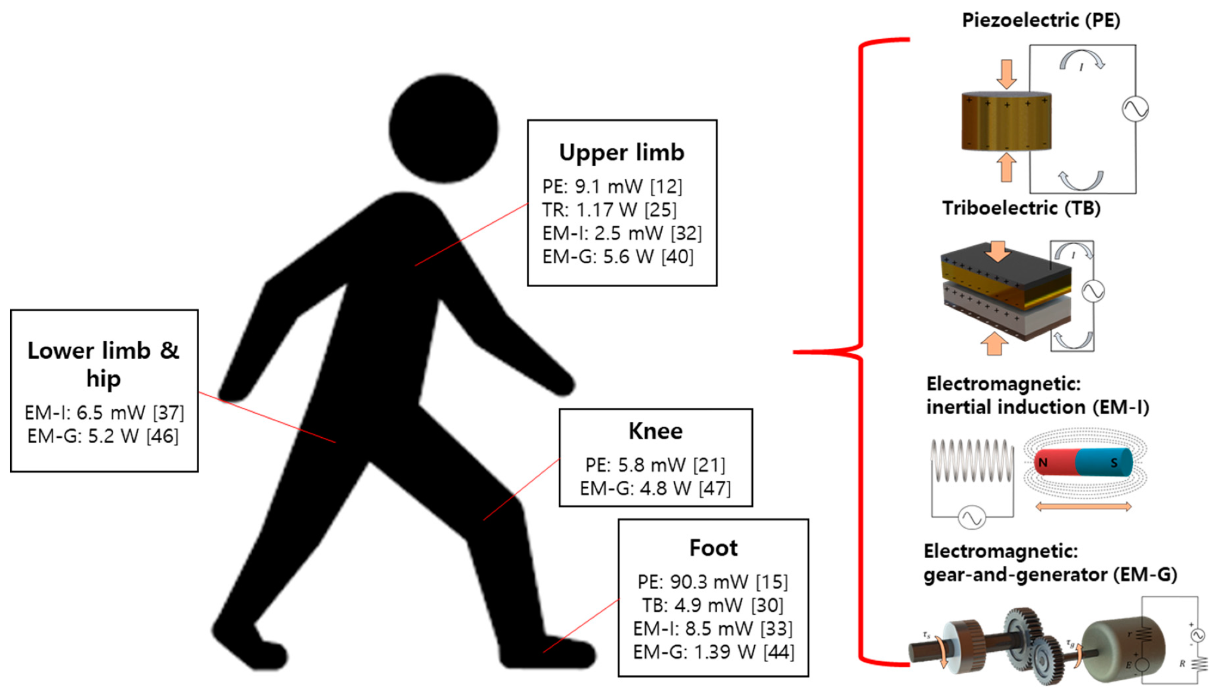
Project Statement
Goal:
To design and produce a device that captures biomechanical energy sufficient to charge a modern day smartphone
Objectives:
Reliable long term performance
Comfortable enough for extended use
Be able to build a marketable prototype
Notes:
Jean

Slide 3
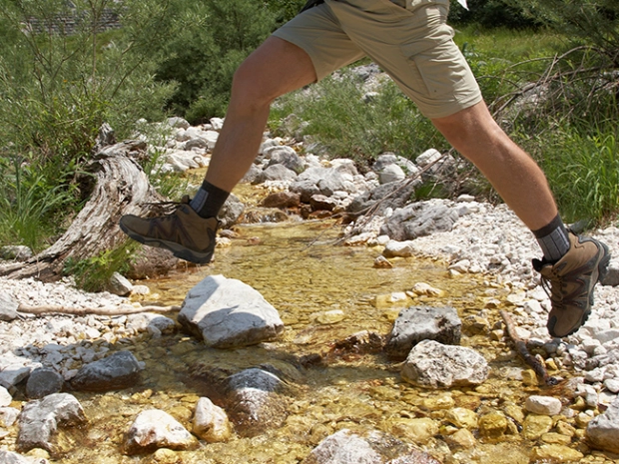
Projected Issues
Material sourcing
Geometric constraints
Efficiency of usable energy production
Energy lost converting to DC current
Mechanical failure and device longevity
Notes:
Jean

Slide 4
Societal/Consumer Needs and Demands
Societal Needs:
Effortless energy harvesting
Inexpensive
environmentally friendly
Customer Needs:
Inexpensive
Lightweight
Comfortable
Durability
effective
Notes:
Nick

Slide 5
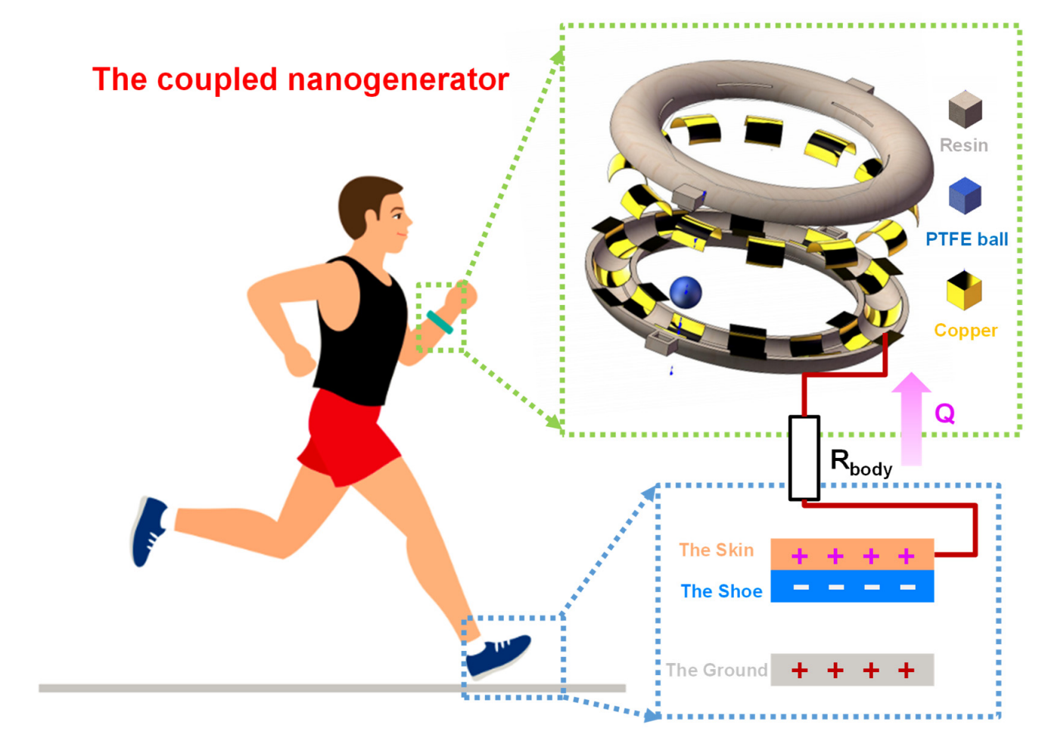
State of the Art Technology Review (Triboelectric)
Triboelectric energy harvesting wristband
Requires very little material to manufacture
Lightweight design that is comfortable for users
Combines triboelectric effect with natural electrostatic energy to amplify power output
Only 3mW of power able to be channeled in practice
Applied as a heartbeat sensor
Notes:
Tim
ball is made of teflon

Slide 6
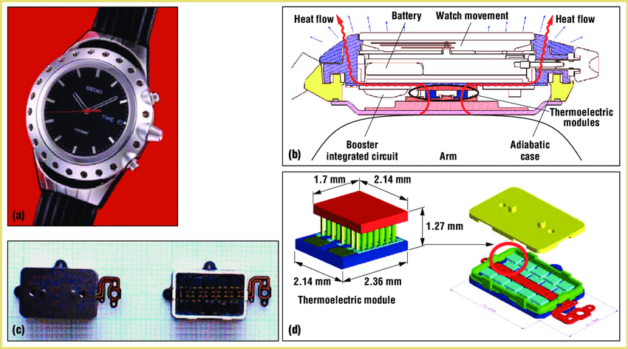
State of the Art Technology Review (Thermoelectric)
Thermoelectric Generators
Vertical, planar, and mixed
Use the difference between ambient temperature and body heat
Artificial latent absorbing tunnels
Latent heat in the nasal passages gets absorbed in the form of energy
Thermal powered watch
Utilizes body heat from the wrist to perpetually operate the watch
Notes:
Tim

Slide 7
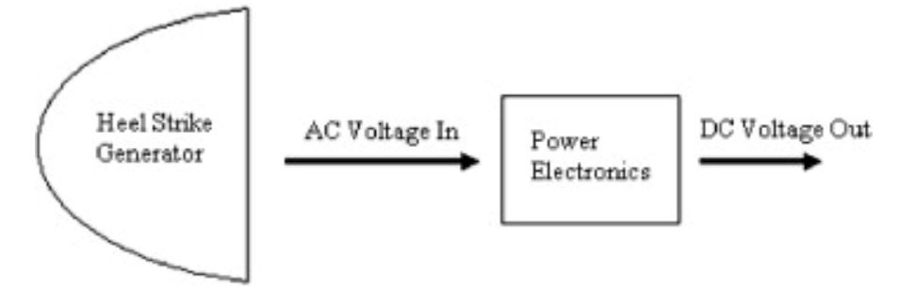
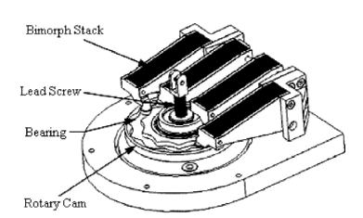
State of the Art Technology Review (Piezoelectric)
Piezoelectric heel strike generator
4 phases of energy generation via PZT-5a plates
Converts to a more usable 12V DC current
Aimed for an output of 0.5W per strike
Produced a power output of 0.0903W per strike
Notes:
Leah
As of now, The heel strike generator is a product that was created to harvest piezoelectric energy.
It works by taking the force of a heel strike as a person walks, and turns a screw and rotary cam which power a gear train
this then bends piezoelectric material continuously to harvest power
Initially, it was hoped the device would put out 0.5W, but it only produced 0.09 W, which in our case, would not charge a cell phone.

Slide 8
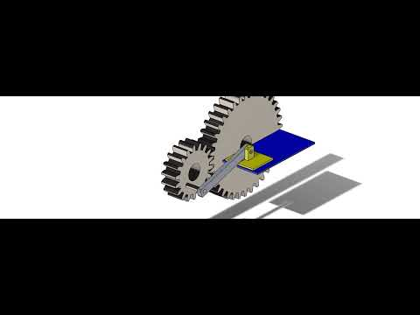
Concept Generation
Triboelectric:
A plunger, powered by the natural movement of the foot powers a gear train that allows two triboelectric materials to rub against each other and provide power
Notes:
Jake

Slide 9
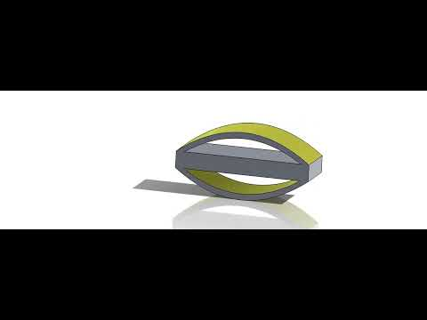
Concept Generation
Piezoelectric
The Chartreuse surfaces would be lined with piezoelectric material and implemented into the heel or toe box of a shoe
When stepped on, this would cause stress on the material which produces power
Notes:
Jake

Slide 10
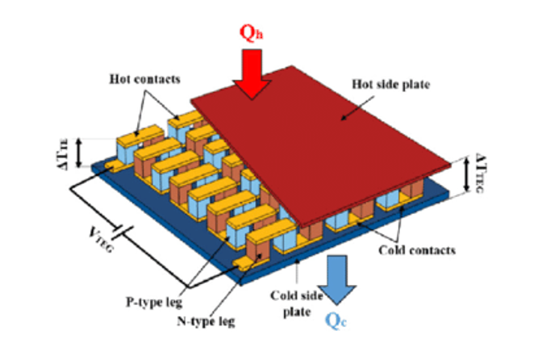
Concept Generation
Thermoelectric
Thermoelectric generators are part of the sole of the shoe
Using mixed TEGs, latent heat from the foot is absorbed and turned into electrical energy
Notes:
Jake

Slide 11
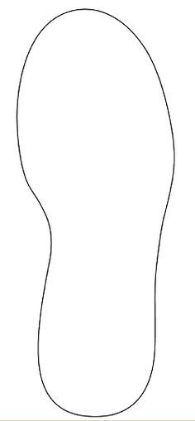
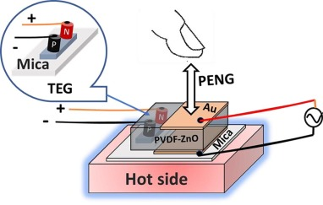
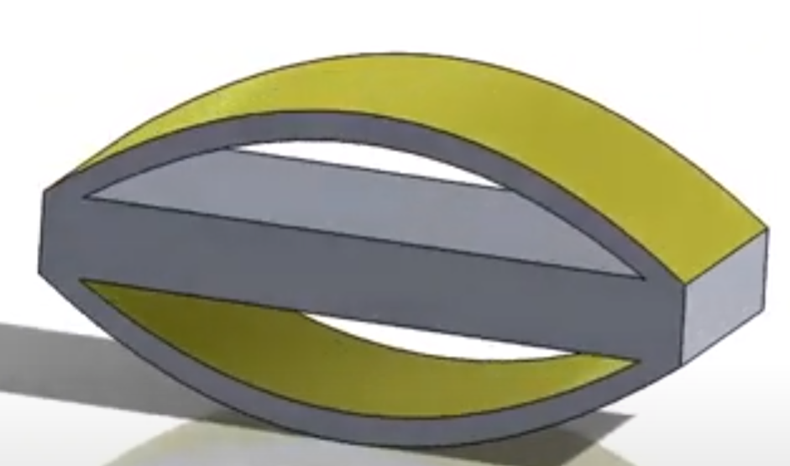
Concept Generation
Combine them!
Piezoelectric material as part of the shoe insole
step = stress and bending = electricity
placed in the toe and the heel of the insole
Thermoelectric generators
hot foot = big temperature difference
temperature difference = electricity :)
placed anywhere that does not have piezoelectric materials
Notes:
Leah
For our final chosen concept, we decided to combine piezoelectric and thermoelectric energy harvesting methods.
Ideally, the piezoelectric materials will be present in high stress areas of the shoe insole like the toe box and the heel, and the thermoelectric generators
will be everywhere else along the insole.
Piezoelectric material produces energy when it is under stress such as bending, and the thermoelectric generators absorb latent heat to convert into
electrical energy. The larger the temperature difference between the ambient temperature and the body temperature, the more energy produced.

Slide 12
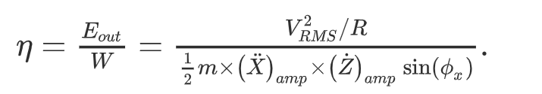
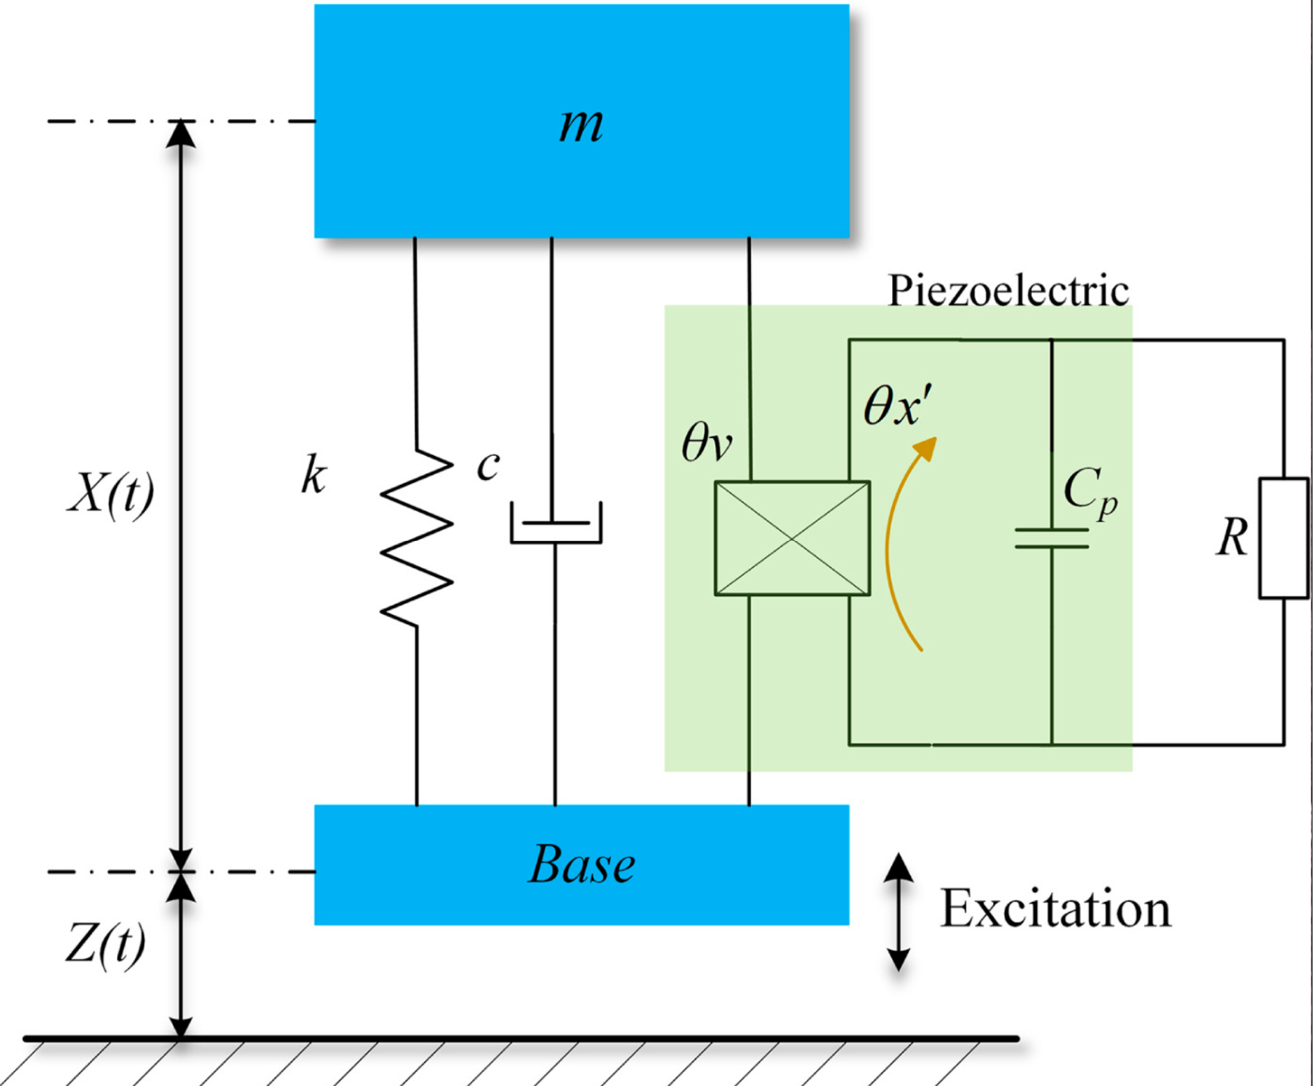
Areas for Technical Analysis in Phase II: Piezoelectric
Establish Figures of Merit (FOM):
Efficiency
Power density
Excitation-normalized power density
Frequency
Bandwidth
Volume
Mass
Excitation Strength
Efficiency equation relating Mechanical Energy Input vs Electrical Output of our nonlinear system. (V_{rms}= root mean square voltage ,R= Resistance , m= mass , X** = absolute acceleration, Z*= velocity of excitation source , sin(ox)= different excitation frequency points (0-180) [1]
From the efficiency equation, the group can select/configure the best material based on extrapolated data [1][2]:
Simplified System Diagram Relating Physical Power to the Electrical System [1]
[1] Yang Z., et al. On the Efficiency of Piezoelectric Energy Harvesters, 2017
[2] Yang Z., et al. High-Performance Piezoelectric Energy Harvesters and Their Applications, 2018
Notes:
Brendan

Slide 13
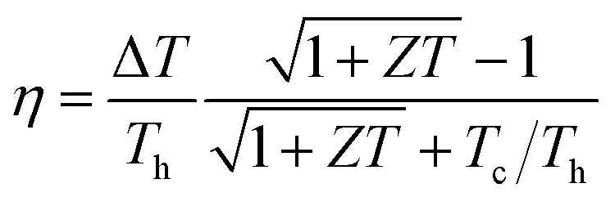
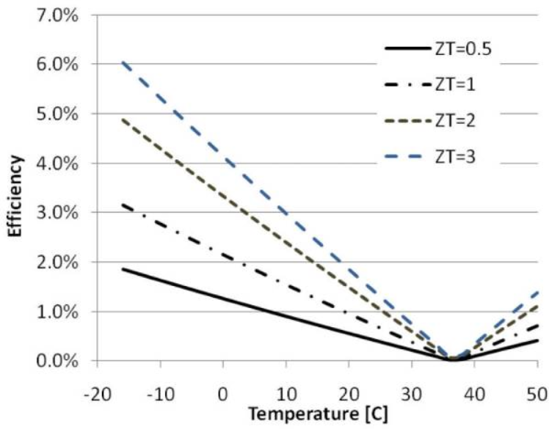
Areas for Technical Analysis in Phase II: Thermoelectric
The efficiency (𝜂) is a measure of the amount of electrical energy produced to thermal energy available.
ZT is the figure of merit, where Z is a function of the Seebeck coefficient, electrical resistivity, and thermal conductivity
An increased ZT causes higher efficiency.
Notes:
Serena

Slide 14
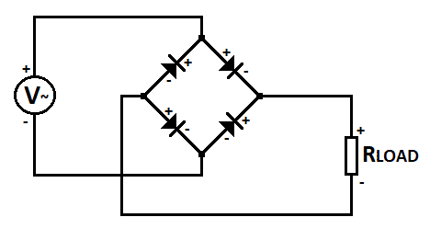
Areas for Technical Analysis in Phase II: Circuitry
Conversion Process:
The electricity generated would have to be converted from AC to DC
Using a bridge rectifier, this will be done
Power Storage:
Lightweight Lithium Polymer (LiPo) battery
Must contain an over-discharge and short-circuit protection circuit
Boosts voltage from generated input current
Schematic of bridge rectifier containing multiple diodes, where R_{Load} represents LiPo collection circuit
Notes:
Alex

Slide 15
Budget Breakdown
Materials
Electrical
Parts ordered online through various retailers
Mechanical
Raw materials to make custom parts
Intricate Parts too difficult to make by hand or power tool
Fabrication Costs
Custom ordered part we cannot create
Renting or buying a tools/software campus doesn’t provide
Notes:
Jack

Slide 16
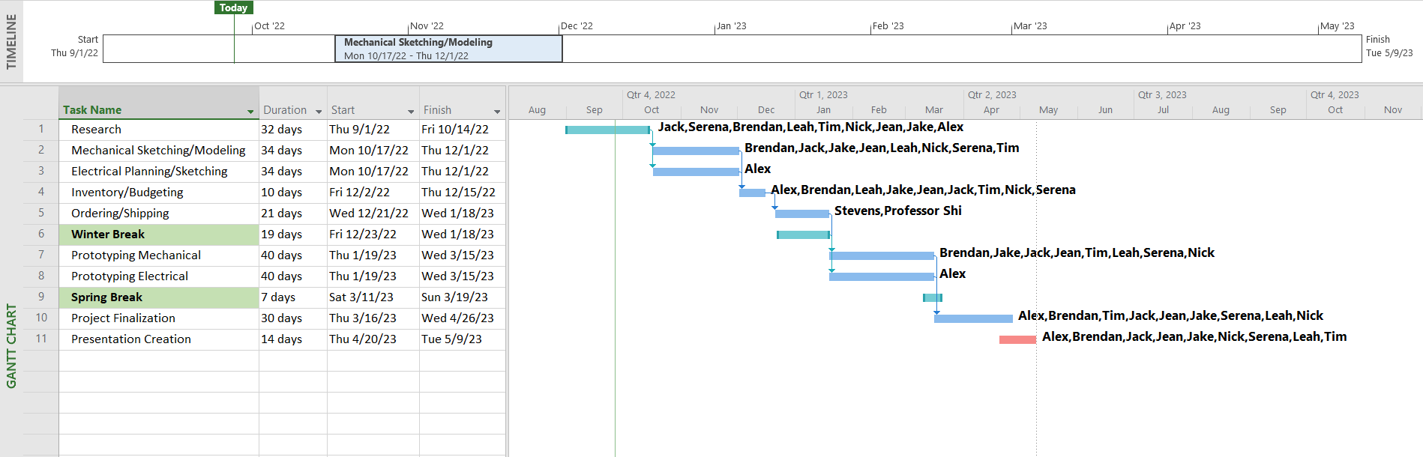

Gantt Chart
Notes:
Jack

Slide 17
Thank You
Any Questions?
Notes:
Leah

